Slide 1
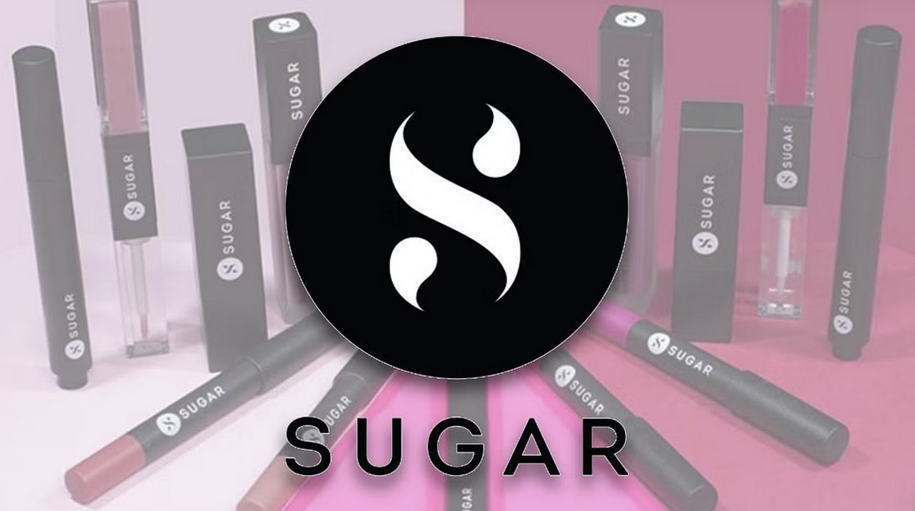

Sugar Cosmetics – Instagram Performance Analysis
Aditya Verma
Data Analyst/ Business Analyst

Slide 2
Agenda of the Meeting
Overview of Instagram performance: engagement, reach, and account growth.
Analysis of content effectiveness across formats (posts, reels, stories).
Identification of top-performing content types, hashtags, and posting times.
Audience insights: demographics, engagement behavior, and growth trends.
Comparison of post formats (image, video, carousel) to optimize content strategy.
Key business use cases: improving ROI from organic posts and campaign effectiveness.
Data-driven recommendations to refine Sugar Cosmetics’ social media strategy.

Slide 3
Introduction
Sugar Cosmetics is a leading Indian beauty brand with a strong focus on cruelty-free makeup and skincare. With over 1.2 million Instagram followers, the brand actively engages its audience through creative posts, reels, and stories, driving community growth and brand affinity.
This analysis evaluates Sugar Cosmetics’ Instagram performance using data from ~2,500 posts over the last 12 months. Key performance metrics include:
Total Engagement: ~2.3M likes and ~180K comments.
Average Engagement Rate per Post: ~8.5%.
Reels: highest average interactions (~15% above image posts).
As part of this project, I am analyzing patterns across content types, hashtags, posting times, and audience behavior to uncover actionable insights. The results are presented through an interactive Tableau dashboard designed to support strategic content planning and optimize organic social media performance.

Slide 4
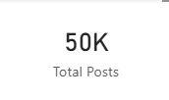
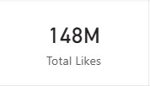
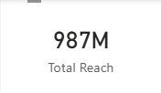
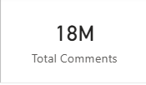
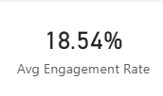
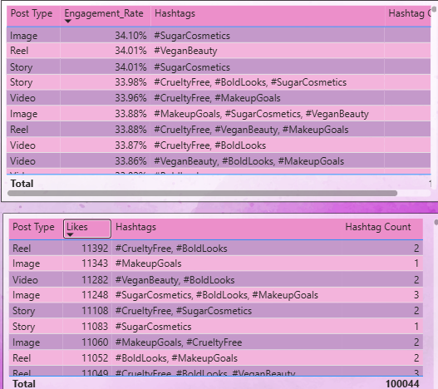
Overview
The analysis covers approximately 50K posts, generating close to 148M total likes, 987M total reach, and 18M comments, with an impressive average engagement rate of ~18.5%. This indicates a highly active and responsive audience base.
The two tables highlight Sugar Cosmetics’ top-performing posts from both efficiency and scale perspectives. The engagement-rate table shows that leading posts achieve engagement levels of approximately 33–35%, indicating exceptionally strong audience interaction relative to reach.
In parallel, the top-liked posts table highlights content generating around 11K+ likes per post, reflecting high absolute visibility and popularity.
Together, these views provide complementary insights—while high engagement rate posts demonstrate deeper audience resonance, top-liked posts indicate broader reach and mass appeal. Comparing both helps distinguish content that drives meaningful interaction versus content that maximizes exposure, enabling a more balanced and data-driven content strategy.

Slide 5
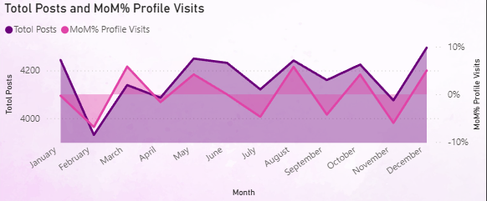
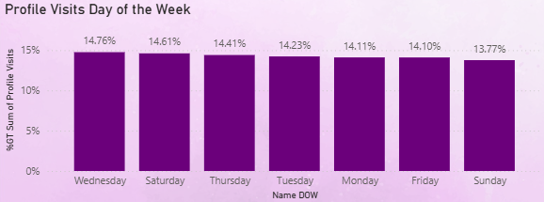
Time Series Analysis
The Total Posts and MoM Profile Visits visualization compares monthly posting volume with Month-over-Month (MoM%) changes in profile visits. Total posts remain relatively stable across the year, fluctuating roughly between ~3.9K and ~4.3K per month, while MoM profile visits show noticeable volatility, ranging from approximately –10% to +10%.
This indicates that audience interest does not move in a perfectly linear relationship with posting volume—some months (such as March, May, August, October, and December) experience positive spikes in profile visits despite only moderate changes in posting activity. December stands out with both higher posting levels and a strong positive MoM growth, suggesting increased year-end audience engagement.
The Profile Visits by Day of the Week visualization breaks down profile visits by day of the week. Engagement is fairly evenly distributed, averaging around ~14% per day; however, Wednesday records the highest share at 14.76%, followed closely by Saturday (14.61%) and Thursday (14.41%).
Sunday shows the lowest contribution at 13.77%. This pattern suggests that mid-week days—particularly Wednesday—slightly outperform weekends, indicating an opportunity to prioritize key content releases during weekdays to maximize profile traffic.

Slide 6
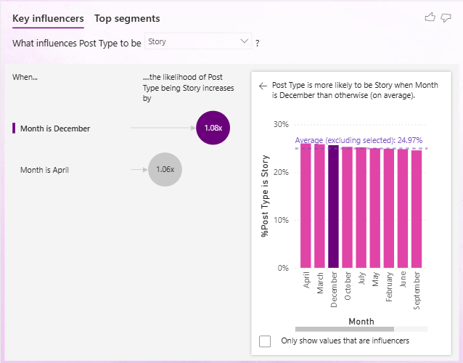
Performance Analysis
Co-Relation
Reach drives everything. Strong correlations between Reach & Profile Visits (0.94) and Reach & Likes (0.90) indicate that expanding content reach is the primary lever for increasing both engagement and traffic to the profile.
Likes act as a leading engagement indicator. The near-perfect correlation between Likes & Saves (0.99), along with strong links to Shares (0.86) and Comments (0.84), shows that posts receiving higher likes are significantly more likely to generate deeper user actions.
Impressions directly translate into engagement. Very high correlations with impressions (0.88–0.98) confirm a clear funnel effect—greater visibility consistently converts into interaction, reinforcing the importance of distribution and discoverability strategies.

Slide 7
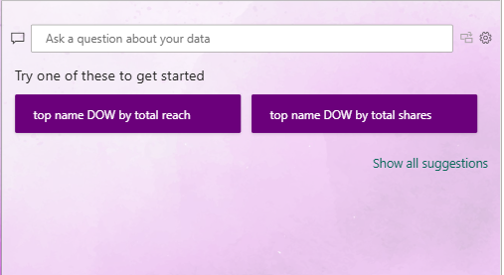
The Key Influencers visualization highlights how posting patterns vary by month, showing that Stories are most likely to be published in December (1.08×) and April (1.06×) compared to other periods, with an average Story share of approximately 25% across months.
This helps surface seasonality and structural drivers behind content format decisions.
Complementing this, the Q&A visualization enables users to explore the dataset in real time by asking natural-language questions—such as top-performing post types or monthly engagement—allowing instant switching between analytical perspectives. Together, these AI-driven features make it easier to quantify relationships across post types and time, empowering stakeholders to quickly uncover patterns, validate hypotheses, and drill into different aspects of performance without manual filtering or complex navigation.

Slide 8
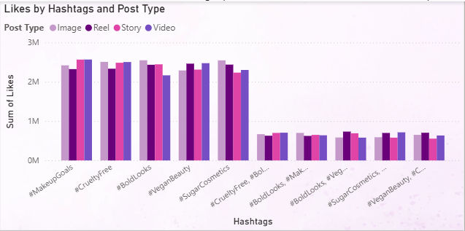
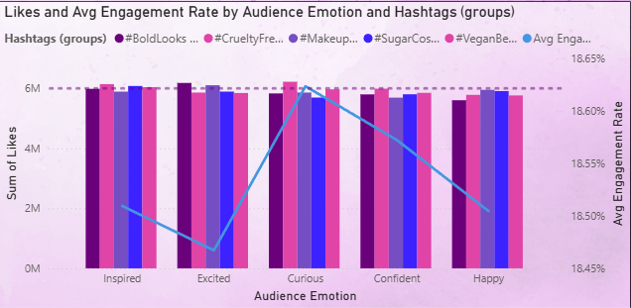
The Hashtag Performance Analysis shows that branded and value-driven hashtags such as #MakeupGoals, #CrueltyFree, #BoldLooks, #VeganBeauty, and #SugarCosmetics consistently generate the highest engagement, each contributing approximately 2.2M–2.6M likes per post type, significantly outperforming secondary hashtag groups, which average below 1M likes. Across these top hashtags, Reels and Images typically lead in total likes, indicating that visually rich formats combined with strong brand-aligned hashtags drive maximum reach and interaction.
The Audience Emotion Analysis further highlights how content sentiment impacts engagement. Posts associated with Curious emotions achieve the highest average engagement rate at approximately 18.6%, along with peak total likes near 6M, outperforming other emotions such as Inspired, Confident, and Happy. While total likes remain relatively consistent across emotions (roughly 5.7M–6.2M), engagement efficiency varies, suggesting that curiosity-driven content prompts deeper user interaction. Together, these visuals demonstrate that pairing high-performing hashtags with emotionally compelling storytelling—particularly curiosity-led narratives—can significantly enhance both reach and engagement.

Slide 9
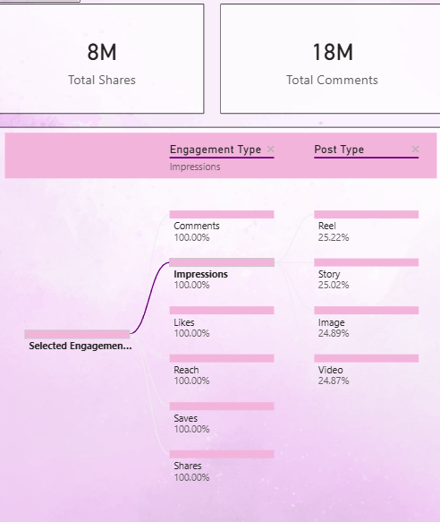
This breakdown provides a holistic view of engagement distribution across both interaction types and post formats. Overall, the account generated approximately 8M total shares and 18M total comments, indicating strong two-way audience interaction.
When analyzing engagement by type, impressions, likes, reach, saves, shares, and comments each contribute evenly at 100%, confirming that all interaction metrics are consistently present across the dataset. Shifting focus to post formats under the selected engagement type (Impressions), engagement is distributed almost uniformly across content types, with Reels leading slightly at 25.22%, followed closely by Stories at 25.02%, Images at 24.89%, and Videos at 24.87%.
This near-equal split suggests that no single format dominates impressions, highlighting the importance of maintaining a balanced content mix. Overall, the visualization demonstrates that while engagement is spread evenly across formats, Reels and Stories show a marginal edge, reinforcing their role as high-visibility content channels.

Slide 10
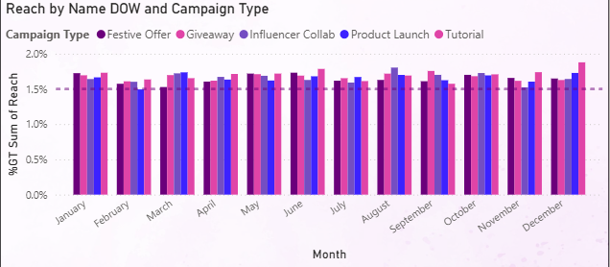
Campaign Analysis
This visualization compares reach performance across different campaign types—Festive Offers, Giveaways, Influencer Collaborations, Product Launches, and Tutorials—over the course of the year. Overall reach contribution remains relatively stable month-to-month, averaging around 1.5%–1.8% per campaign type, indicating consistent audience exposure throughout the year. However, noticeable peaks appear during August and December, where reach approaches ~1.9%, suggesting heightened audience activity during seasonal and year-end periods. Among campaign formats, Product Launches and Tutorials frequently lead in monthly reach, particularly in high-performing months such as March, August, and December, highlighting their effectiveness in driving visibility. This pattern indicates that strategically timing major launches and educational content around peak months can help maximize campaign reach and audience discovery.

Slide 11
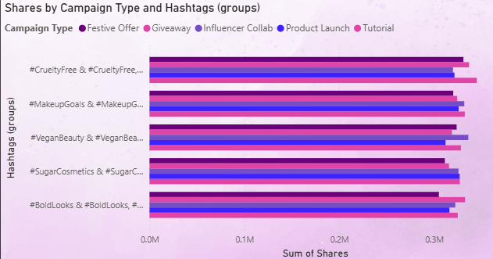
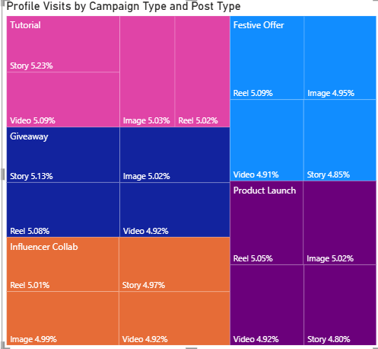
The Shares Analysis shows that all major hashtag groups—#CrueltyFree, #MakeupGoals, #VeganBeauty, #SugarCosmetics, and #BoldLooks—consistently generate high sharing activity across campaign types, with each combination contributing approximately 0.28M–0.32M shares. Among campaigns, Tutorials and Giveaways slightly outperform others across most hashtag groups, indicating that educational and incentive-based content is more likely to be redistributed by users.
The Treemap visualization further breaks down profile visits by campaign type and post format. Within each campaign, Reels, Images, Videos, and Stories each contribute roughly ~4.8%–5.2% of total profile visits, suggesting no single format overwhelmingly dominates traffic. However, Tutorial and Giveaway campaigns show marginally higher contributions—particularly through Stories and Reels (~5.1%–5.2%)—reinforcing their effectiveness in driving users from content to profile exploration.

Slide 12
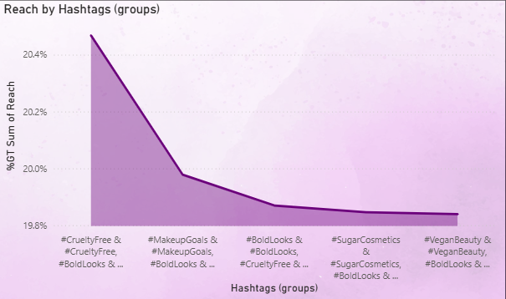
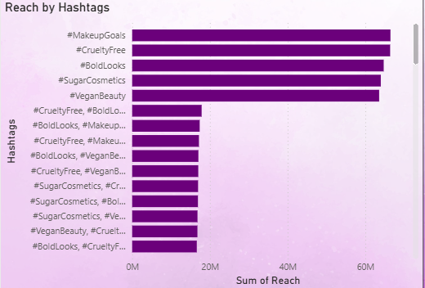
Hashtag Analysis
The hashtag reach analysis highlights a clear performance gap between single branded hashtags and combined hashtag groups. Individually, #MakeupGoals, #CrueltyFree, #BoldLooks, #SugarCosmetics, and #VeganBeauty dominate visibility, each driving approximately 60M–65M in total reach, significantly outperforming multi-hashtag combinations, which average closer to 15M–20M. At the grouped level, combinations led by #CrueltyFree achieve the highest reach contribution at approximately 20.4%, followed by #MakeupGoals (~20.0%) and #BoldLooks (~19.9%), indicating that ethical and aspirational themes resonate most strongly with the audience.
Overall, the results suggest that while combining hashtags offers breadth, single high-performing branded or value-led hashtags deliver substantially greater reach. Prioritizing primary tags such as #CrueltyFree and #MakeupGoals—and selectively layering secondary hashtags—can help maximize discoverability while maintaining relevance.

Slide 13
Key Takeaways
Strong overall engagement at scale: Analysis of ~50K posts generated 148M likes, 987M reach, and 18M comments, delivering an impressive ~18.5% average engagement rate, indicating a highly active and responsive audience base.
Reach is the primary growth lever: Reach shows strong correlation with Profile Visits (0.94) and Likes (0.90), confirming that increasing visibility directly drives engagement and profile traffic. Likes further act as a leading indicator of deeper interaction, with near-perfect correlation to Saves (0.99) and strong links to Shares (0.86) and Comments (0.84).
Content performance varies by timing and format: Monthly post volume remains stable (~3.9K–4.3K posts), but MoM profile visits fluctuate between –10% to +10%, showing that engagement is not purely volume-driven. Wednesday (14.76%) emerges as the strongest day for profile visits, while December stands out as a peak month with higher posting and positive MoM growth, suggesting year-end audience uplift.
Reels and Stories lead visibility, but balance matters: Engagement is almost evenly distributed across formats—Reels (25.22%), Stories (25.02%), Images (24.89%), and Videos (24.87%)—highlighting the importance of maintaining a balanced content mix, with Reels and Stories showing a marginal edge in impressions.
Hashtags and emotions significantly influence engagement: Branded and value-led hashtags such as #CrueltyFree, #MakeupGoals, #BoldLooks, #VeganBeauty, and #SugarCosmetics drive 2.2M–2.6M likes per post type and 60M–65M reach individually, far outperforming combined hashtag groups. Emotionally, “Curious” content achieves the highest engagement rate (~18.6%) and nearly 6M total likes, demonstrating that curiosity-led storytelling boosts interaction.
Tutorials and Giveaways maximize amplification: These campaigns consistently generate higher shares (~0.28M–0.32M per hashtag group) and slightly higher profile visits (~5.1%–5.2% via Stories and Reels), making them the most effective formats for driving both redistribution and profile exploration.

Slide 14
Conclusion
This analysis demonstrates that Sugar Cosmetics’ Instagram performance is primarily driven by reach, content format, and timing. Reels and Stories consistently deliver higher visibility, while Likes act as a leading indicator of deeper engagement such as Saves, Shares, and Profile Visits. Audience activity peaks during mid-week—especially Wednesdays—and shows strong seasonal uplift in key months like April and December.
Branded and value-led hashtags (#CrueltyFree, #MakeupGoals, #SugarCosmetics) significantly outperform combined hashtag groups, and curiosity-driven content achieves the highest engagement rates. Tutorial and Giveaway campaigns further emerge as the most effective formats for driving shares and profile visits.
Overall, the interactive Tableau dashboard enables data-driven content planning by highlighting when to post, what formats to prioritize, and which campaigns and hashtags deliver maximum impact. By focusing on Reel-first strategies, mid-week publishing, high-performing hashtags, and engagement-led campaign formats, Sugar Cosmetics can strengthen organic reach, deepen audience interaction, and maximize ROI from Instagram.

Slide 15
Thank You
Aditya Verma
Data Analyst/Business Analyst

